Slide 1
Developing mathematical and epidemiological intuition for the basic reproduction number
Andrew Brouwer
University of Michigan
November 10, 2021

Slide 2



Basic reproduction number
“Expected number of secondary cases arising from a typical primary case in an entirely susceptible population over their infectious period.”
$$R_{0}=2$$
$$R_{0}=3$$

Slide 3
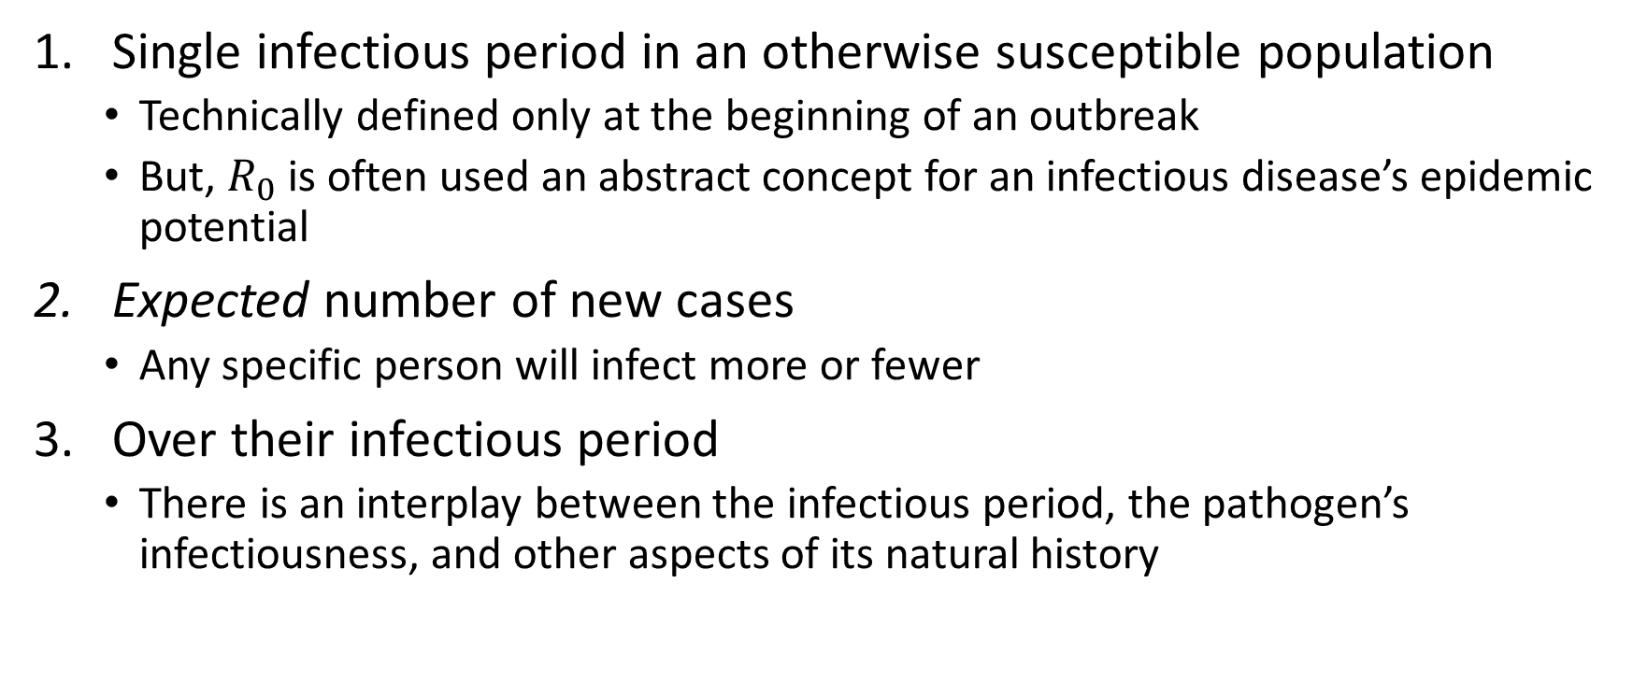
Key aspects of the definition
Single infectious period in an otherwise susceptible population
Technically defined only at the beginning of an outbreak
But, $R_{0}$ is often used an abstract concept for an infectious disease’s epidemic potential
Expected number of new cases
Any specific person will infect more or fewer
Over their infectious period
There is an interplay between the infectious period, the pathogen’s infectiousness, and other aspects of its natural history

Slide 4
The “DOTS”
The basic reproduction number can be thought of as the product of
D: duration
O: opportunity
T: transmission probability
S: susceptibility
Kucharski, 2020

Slide 5

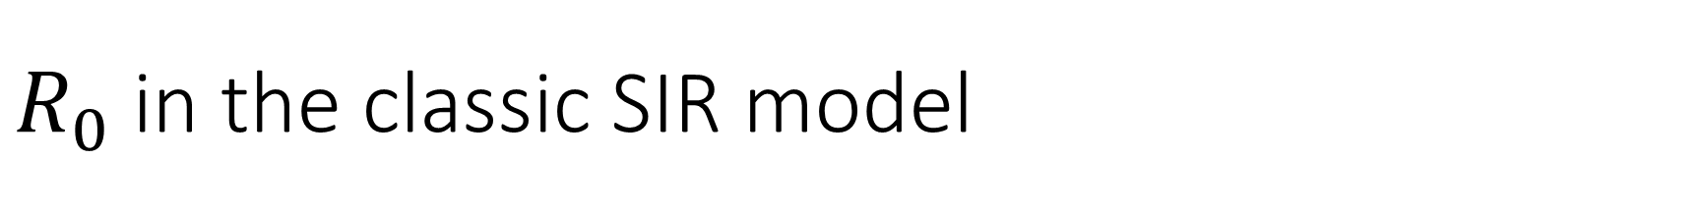


$R_{0}$ in the classic SIR model
In the classic SIR model, $R_{0}$ is the contact rate times the average duration of the infectious period
$$\frac{dS}{dt}=−βIS$$
$$\frac{dI}{dt}=βIS−γI$$
$$\frac{dR}{dt}=γI$$
$R_{0}=\frac{1}{γ}×$ $β$
Average infectious period
“D”
Transmission rate
“OTS”

Slide 6
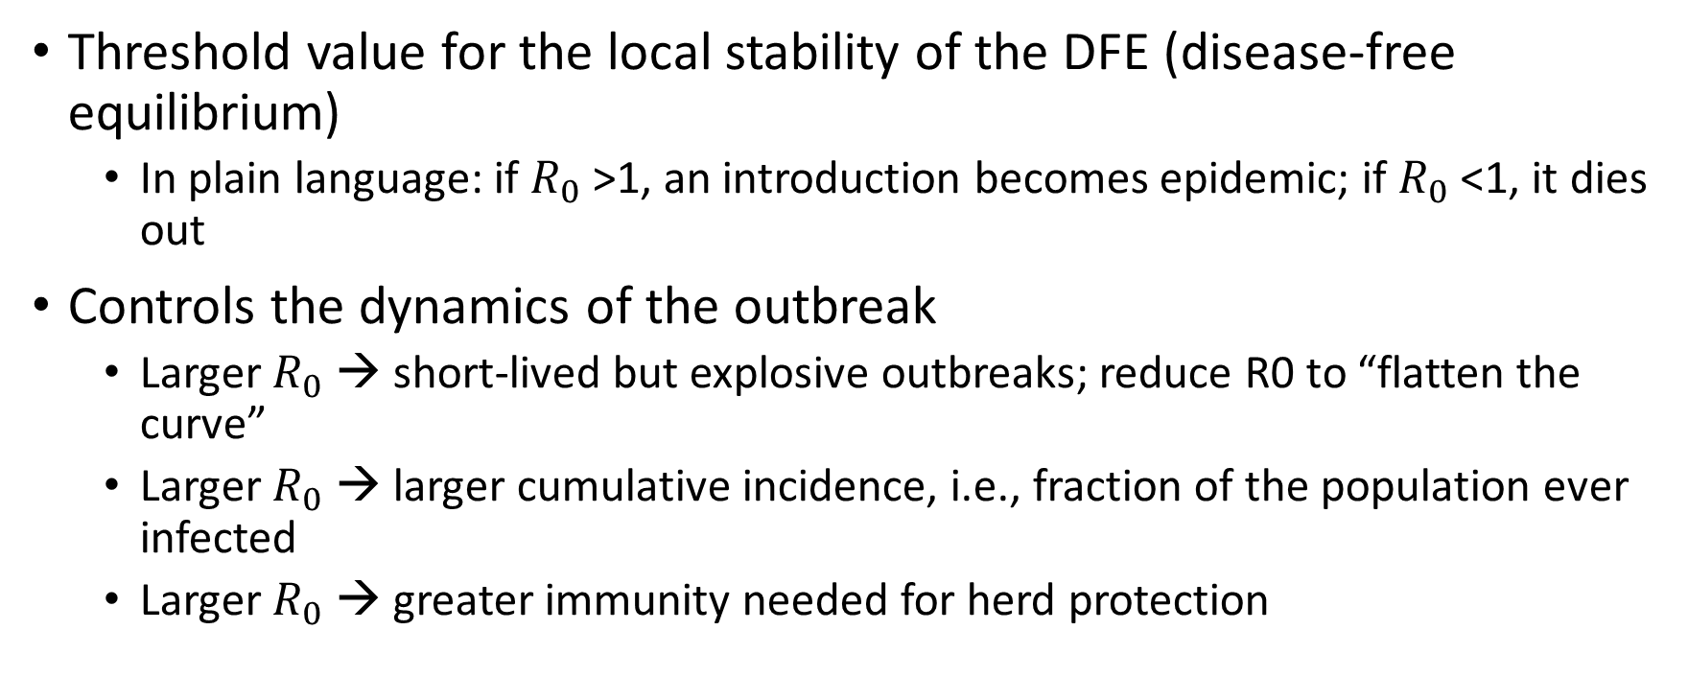
Why is the reproduction number important?
Threshold value for the local stability of the DFE (disease-free equilibrium)
In plain language: if $R_{0}$>1, an introduction becomes epidemic; if $R_{0}$<1, it dies out
Controls the dynamics of the outbreak
Larger $R_{0}$ → short-lived but explosive outbreaks; reduce R0 to “flatten the curve”
Larger $R_{0}$ → larger cumulative incidence, i.e., fraction of the population ever infected
Larger $R_{0}$ → greater immunity needed for herd protection

Slide 7
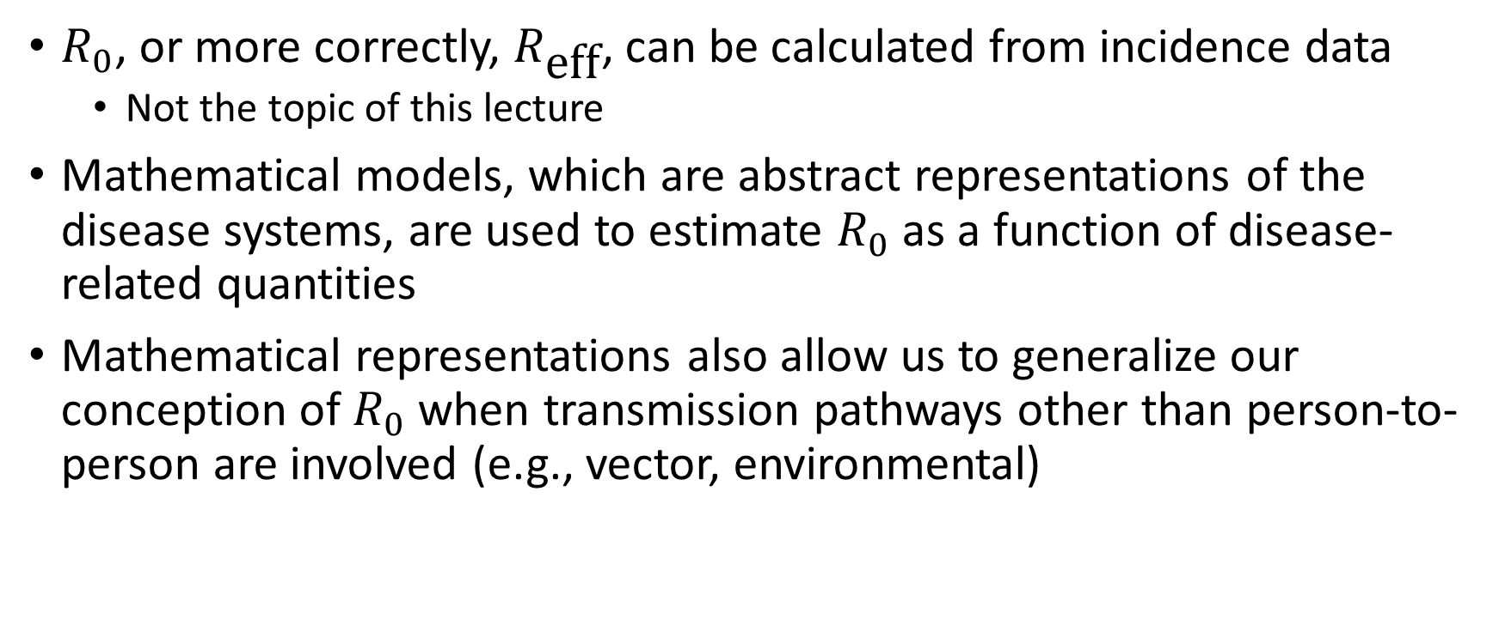
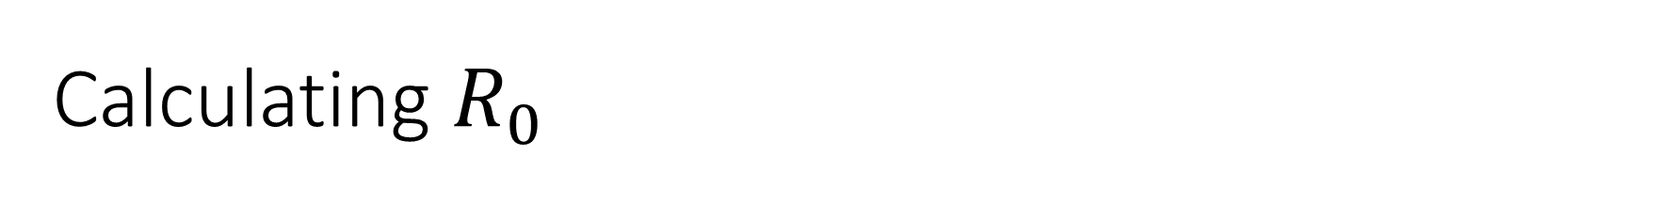
Calculating $R_{0}$
$R_{0}$, or more correctly, $R_{\text{eff}}$, can be calculated from incidence data
Not the topic of this lecture
Mathematical models, which are abstract representations of the disease systems, are used to estimate $R_{0}$ as a function of disease-related quantities
Mathematical representations also allow us to generalize our conception of $R_{0}$ when transmission pathways other than person-to-person are involved (e.g., vector, environmental)

Slide 8
The Next Generation Matrix and its geometry

Slide 9

The Next Generation Method
Most common and rigorous approach to calculating $R_{0}$ from a mathematical model
Developed by Heesterbeek, Diekmann, and colleagues (1990); popularized by Pauline van den Driessche (2002). See references at end of presentation.

Slide 10
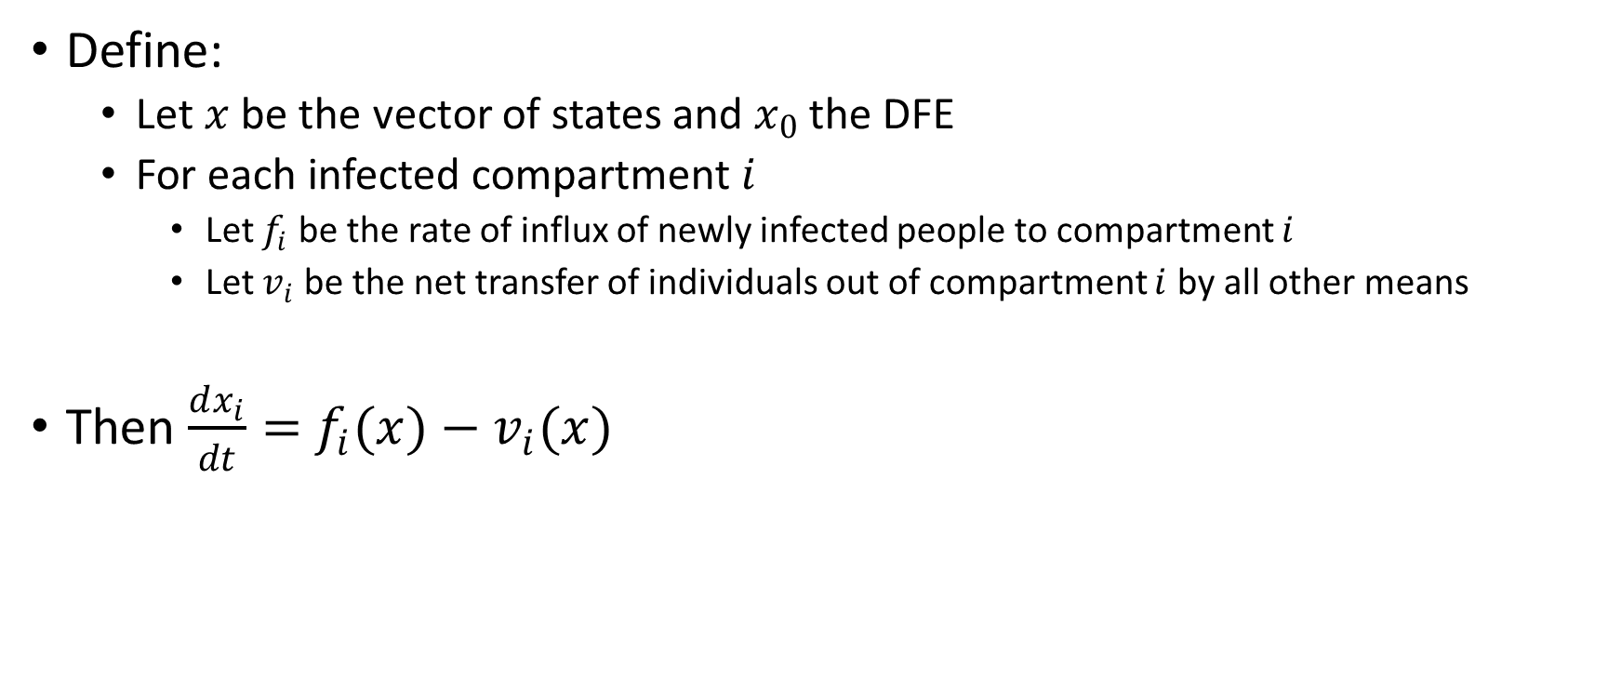
The Next Generation Method, part 1
Define:
Let $x$ be the vector of states and $x_{0}$ the DFE
For each infected compartment $i$
Let $f_{i}$ be the rate of influx of newly infected people to compartment $i$
Let $v_{i}$ be the net transfer of individuals out of compartment $i$ by all other means
Then $\frac{dx_{i}}{dt}=$ $f_{i}(x)−v_{i}(x)$

Slide 11
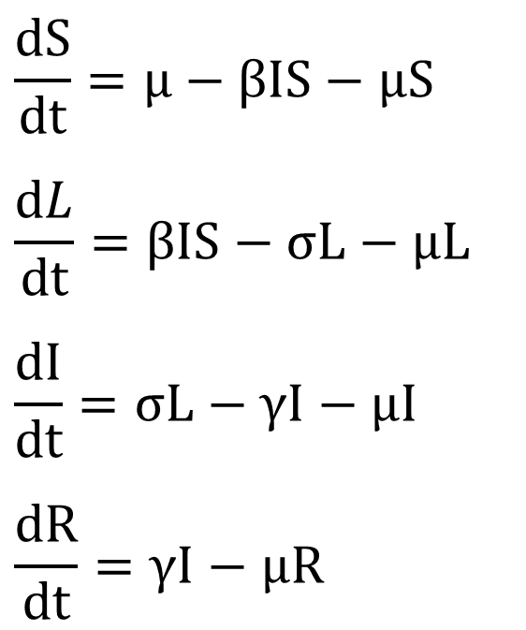
SLIR model with demography
$$\frac{dS}{dt}=μ−βIS−μS$$
$$\frac{dL}{dt}=βIS−σL−μL$$
$$\frac{dI}{dt}=σL−γI−μI$$
$$\frac{dR}{dt}=γI−μR$$
Susceptible
Latent
Recovered
Infectious

Slide 12
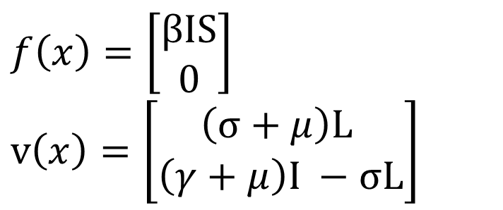
SLIR model with demography
$$\frac{dS}{dt}=μ−βIS−μS$$
$$\frac{dL}{dt}=βIS−σL−μL$$
$$\frac{dI}{dt}=σL−γI−μI$$
$$\frac{dR}{dt}=γI−μR$$
$$f\left(x\right)=\left[\begin{matrix}βIS \\ 0\end{matrix}\right]$$
$$v\left(x\right)=\left[\begin{matrix}\left(σ+μ\right)\text{L} \\ \left(γ+μ\right)I −σ\text{L}\end{matrix}\right]$$
infected
new

Slide 13
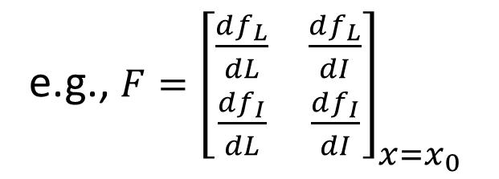

The Next Generation Method, part 2
Define:
Let $F$ and $V$ be the Jacobians (matrix of 1st derivatives) of $f$ and $v$ evaluated at the disease-free equilibrium
That is
$F_{ij}={\left.\frac{df_{i}}{dx_{j}}\right|}_{x=x_{0}}$
$V_{ij}={\left.\frac{dv_{i}}{dx_{j}}\right|}_{x=x_{0}}$
e.g., $F={\left[\begin{matrix}\frac{df_{L}}{dL} & \frac{df_{L}}{dI} \\ \frac{df_{I}}{dL} & \frac{df_{I}}{dI}\end{matrix}\right]}_{x=x_{0}}$

Slide 14
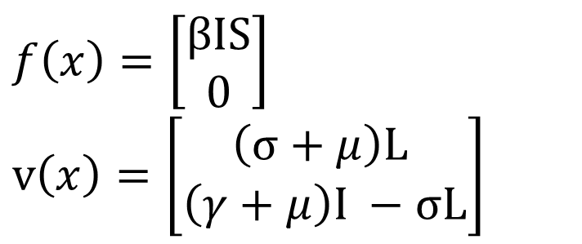

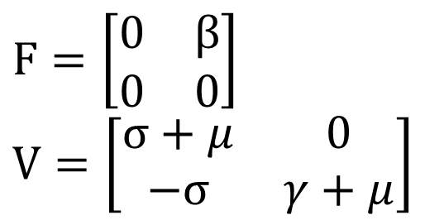
SLIR model with demography
$$\frac{dS}{dt}=μ−βIS−μS$$
$$\frac{dL}{dt}=βIS−σL−μL$$
$$\frac{dI}{dt}=σL−γI−μI$$
$$\frac{dR}{dt}=γI−μR$$
$$f\left(x\right)=\left[\begin{matrix}βIS \\ 0\end{matrix}\right]$$
$$v\left(x\right)=\left[\begin{matrix}\left(σ+μ\right)\text{L} \\ \left(γ+μ\right)I −σ\text{L}\end{matrix}\right]$$
infected
new
$$F=\left[\begin{matrix}0 & β \\ 0 & 0\end{matrix}\right]$$
$$V=\left[\begin{matrix}σ+μ & 0 \\ −σ & γ+μ\end{matrix}\right]$$
$$x_{0}=(1,0,0,0)$$

Slide 15

The Next Generation Method, part 3
The matrix $FV^{−1}$ is called the next generation matrix
The basic reproduction number is the spectral radius (largest eigenvalue) of the next generation matrix.

Slide 16

The Next Generation Method, part 3
The matrix $FV^{−1}$ is called the next generation matrix
The basic reproduction number is the spectral radius (largest eigenvalue) of the next generation matrix.
Sorry, what? Why?

Slide 17

Understanding the Next Generation Method
The matrix $V^{−1}$ is a matrix of residence times.
Imagine a newly infected individual entering compartment k:
The (j, k) entry of $V^{−1}$is the average length of time this individual spends in compartment j during its lifetime, assuming that the population remains near the DFE and barring reinfection.
-van den Driessche & Watmough, 2002

Slide 18


Understanding the Next Generation Method
The matrix $V^{−1}$ is a matrix of residence times.
Imagine a newly infected individual entering compartment k:
The (j, k) entry of $V^{−1}$is the average length of time this individual spends in compartment j during its lifetime, assuming that the population remains near the DFE and barring reinfection.
-van den Driessche & Watmough, 2002
Starting in L, you leave when you recover or die.
Starting in I, you never go to L.
$$V^{−1}=\left[\begin{matrix}\frac{1}{\left(σ+μ\right)} & 0 \\ \frac{σ}{\left(σ+μ\right)\left(γ+μ\right)} & \frac{1}{\left(γ+μ\right)}\end{matrix}\right]$$
Starting in L, you go on to I, unless you die first.
Starting in I, you recover or die.

Slide 19
Understanding the Next Generation Method
The matrix F is a matrix of rate of new infections.
The (𝑖,𝑗) entry of 𝐹 is the rate at which infected individuals in compartment 𝑗 produce a new infection in compartment 𝑖.
-van den Driessche & Watmough, 2002

Slide 20

Understanding the Next Generation Method
The matrix F is a matrix of rate of new infections.
The (𝑖,𝑗) entry of 𝐹 is the rate at which infected individuals in compartment 𝑗 produce a new infection in compartment 𝑖.
-van den Driessche & Watmough, 2002
Only people in compartment I make new infected people, and those new infected people all start in L.
$$F=\left[\begin{matrix}0 & β \\ 0 & 0\end{matrix}\right]$$
Latent people are not (yet) infectious.

Slide 21

Understanding the Next Generation Method
The matrix $FV^{−1}$ is called the next generation matrix
Hence, the (i, k) entry of the product $FV^{−1}$is the expected number of new infections in compartment i produced by the infected individual originally introduced into compartment k.
-van den Driessche & Watmough, 2002

Slide 22
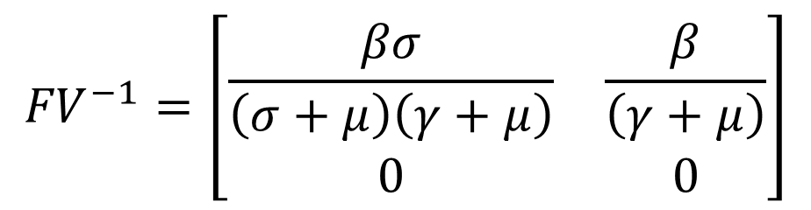

Understanding the Next Generation Method
The matrix $FV^{−1}$ is called the next generation matrix
Hence, the (i, k) entry of the product $FV^{−1}$is the expected number of new infections in compartment i produced by the infected individual originally introduced into compartment k.
-van den Driessche & Watmough, 2002
$${FV}^{−1}=\left[\begin{matrix}\frac{βσ}{\left(σ+μ\right)\left(γ+μ\right)} & \frac{β}{\left(γ+μ\right)} \\ 0 & 0\end{matrix}\right]$$
Infected people make new exposed, not new infectious.

Slide 23
Understanding the Next Generation Method
Okay, we can interpret the entries of the next generation matrix, but why the spectral radius?

Slide 24

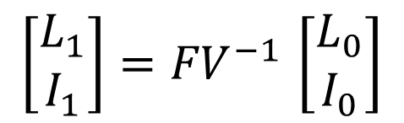
Geometry of the NGM
Near the disease-free equilibrium, the process of making the next generation is approximately linear.
We can use the geometry of linear systems!
Next generation operator
$$\left[\begin{matrix}L_{1} \\ I_{1}\end{matrix}\right]{=FV}^{−1}\left[\begin{matrix}L_{0} \\ I_{0}\end{matrix}\right]$$
Next generation
$$y=Ax$$
Previous generation
Linear system

Slide 25
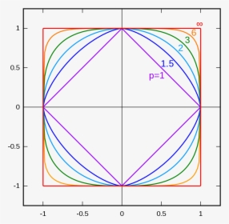
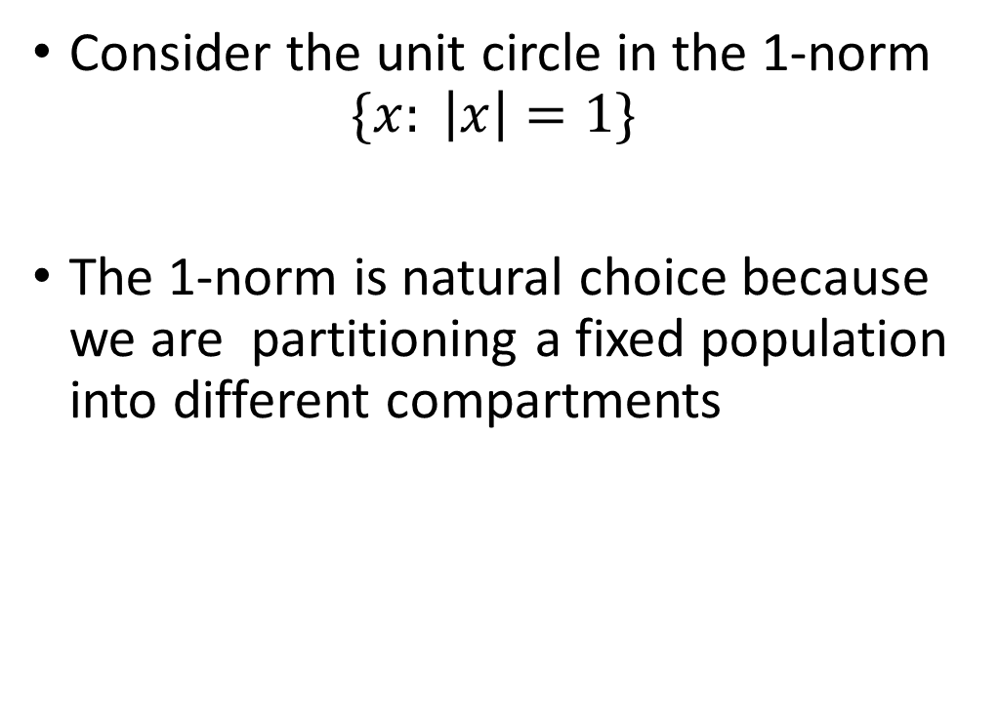
Geometry of the NGM
Consider the unit circle in the 1-norm
$$\{x: \left|x\right|=1\}$$
The 1-norm is natural choice because we are partitioning a fixed population into different compartments

Slide 26
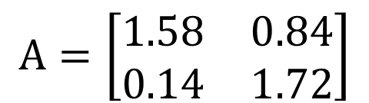


Geometry of the NGM
Largest possible next generation
Apply a linear transformation to a circle
$\left\|A\right\|=$2.56
$$A=\left[\begin{matrix}1.58 & 0.84 \\ 0.14 & 1.72\end{matrix}\right]$$
$$\{Ax: \left|x\right|=1\}$$
Eigenvector corresponding to largest eigenvalue
The size of the next generation depends on the partition of the previous generation.
$ρ\left(A\right)=$2

Slide 27
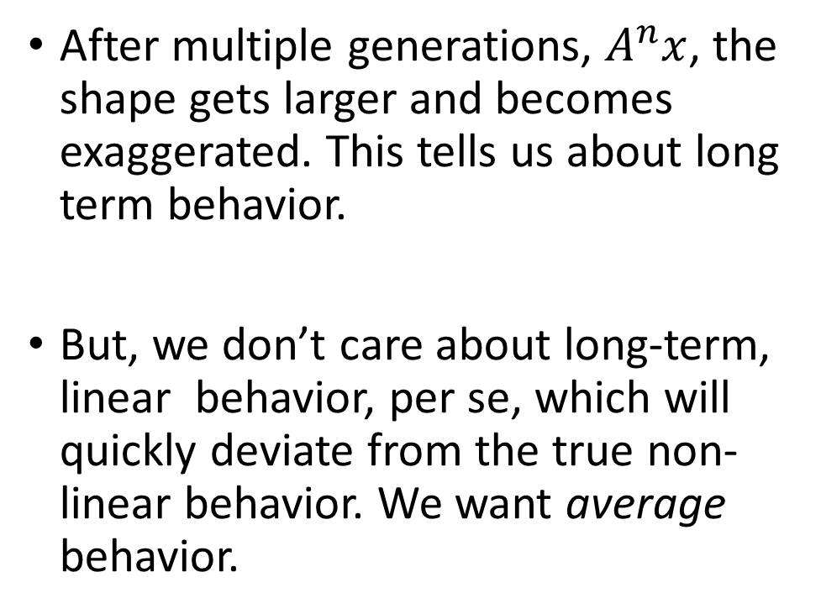
Geometry of the NGM
After multiple generations, $A^{n}x$, the shape gets larger and becomes exaggerated. This tells us about long term behavior.
But, we don’t care about long-term, linear behavior, per se, which will quickly deviate from the true non-linear behavior. We want average behavior.

Slide 28
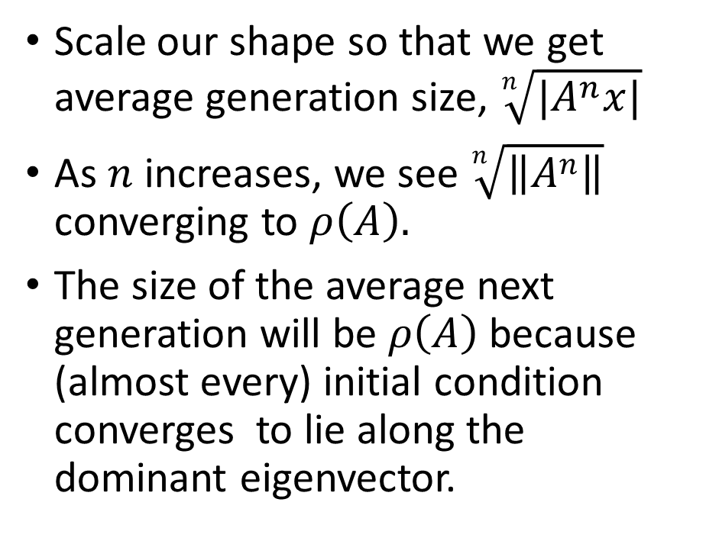
Geometry of the NGM
Scale our shape so that we get average generation size, $\sqrt[n]{|A^{n}x|}$
As $n$ increases, we see $\sqrt[n]{\left\|A^{n}\right\|}$ converging to $ρ\left(A\right).$
The size of the average next generation will be $ρ\left(A\right)$ because (almost every) initial condition converges to lie along the dominant eigenvector.

Slide 29
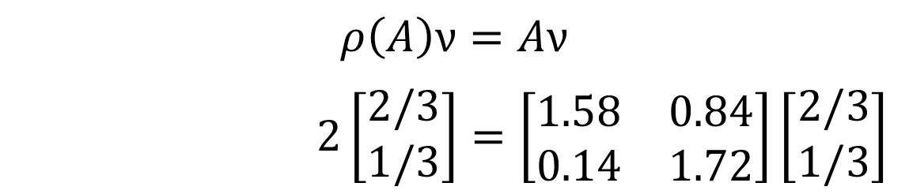
Geometry of the NGM
The eigenvector corresponding to the largest eigenvalue of A also has a useful interpretation. It is the stable distribution of the infectious compartments.
Note that this stable distribution is unlikely to manifest in reality because an epidemic quickly leaves the vicinity of the DFE where this analysis is valid.
$$ρ\left(A\right)ν=Aν$$
$2\left[\begin{matrix}2/3 \\ 1/3\end{matrix}\right]=\left[\begin{matrix}1.58 & 0.84 \\ 0.14 & 1.72\end{matrix}\right]\left[\begin{matrix}2/3 \\ 1/3\end{matrix}\right]$

Slide 30
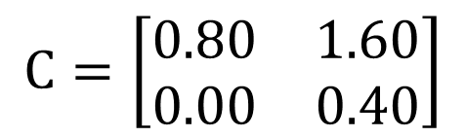
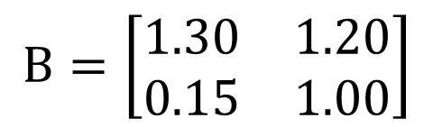
Additional examples
$$B=\left[\begin{matrix}1.30 & 1.20 \\ 0.15 & 1.00\end{matrix}\right]$$
$$C=\left[\begin{matrix}0.80 & 1.60 \\ 0.00 & 0.40\end{matrix}\right]$$
Eigenvalues: 1.6, 0.7
Eigenvalues: 0.8, 0.4

Slide 31
Developing symbolic interpretations of the NGM

Slide 32
Interpreting the NGM
We now have a better understanding why the spectral radius is the right measure.
But we still may struggle with interpreting the NGM matrix in terms of our parameters, especially in higher dimensional cases.

Slide 33


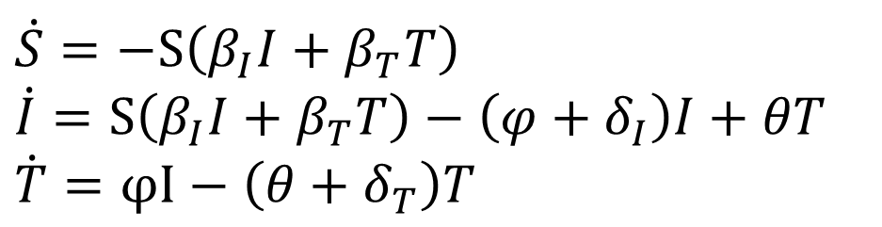

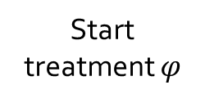

Example: Treatment compliance
Infected individuals can go on and off a treatment that reduces their infectivity and mortality rate
$$\dot{S}=−S\left(β_{I}I+β_{T}T\right)$$
$$\dot{I}=S\left(β_{I}I+β_{T}T\right)−\left(φ+δ_{I}\right)I+θT$$
$$\dot{T}=φI−\left(θ+δ_{T}\right)T$$
Lapse $θ$
Susceptible
Infected
Treatment
Infection $\left(β_{I}I+β_{T}T\right)$
Start treatment $φ$
Death $δ_{I}$
Death $δ_{T}$

Slide 34
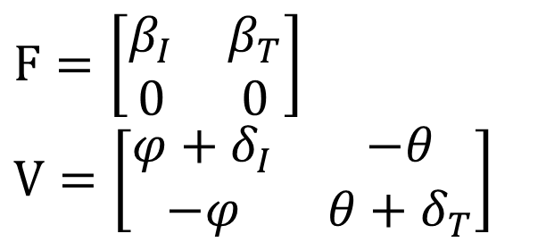
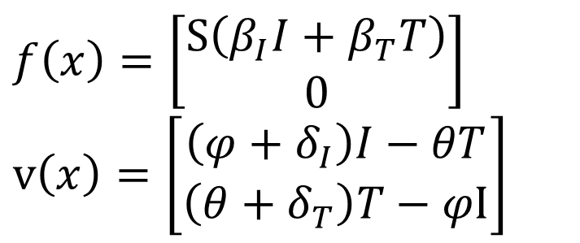
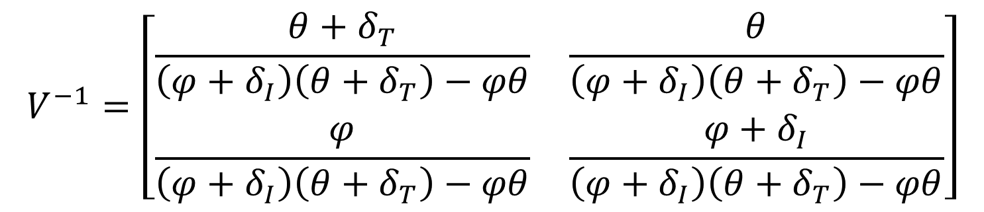
Example: Treatment compliance
$$f\left(x\right)=\left[\begin{matrix}S\left(β_{I}I+β_{T}T\right) \\ 0\end{matrix}\right]$$
$$v\left(x\right)=\left[\begin{matrix}\left(φ+δ_{I}\right)I−θT \\ \left(θ+δ_{T}\right)T−φI\end{matrix}\right]$$
$$F=\left[\begin{matrix}β_{I} & β_{T} \\ 0 & 0\end{matrix}\right]$$
$$V=\left[\begin{matrix}φ+δ_{I} & −θ \\ −φ & θ+δ_{T}\end{matrix}\right]$$
$$V^{−1}=\left[\begin{matrix}\frac{θ+δ_{T}}{\left(φ+δ_{I}\right)\left(θ+δ_{T}\right)−φθ} & \frac{θ}{\left(φ+δ_{I}\right)\left(θ+δ_{T}\right)−φθ} \\ \frac{φ}{\left(φ+δ_{I}\right)\left(θ+δ_{T}\right)−φθ} & \frac{φ+δ_{I}}{\left(φ+δ_{I}\right)\left(θ+δ_{T}\right)−φθ}\end{matrix}\right]$$

Slide 35
Example: Treatment compliance
$$f\left(x\right)=\left[\begin{matrix}S\left(β_{I}I+β_{T}T\right) \\ 0\end{matrix}\right]$$
$$v\left(x\right)=\left[\begin{matrix}\left(φ+δ_{I}\right)I−θT \\ \left(θ+δ_{T}\right)T−φI\end{matrix}\right]$$
$$F=\left[\begin{matrix}β_{I} & β_{T} \\ 0 & 0\end{matrix}\right]$$
$$V=\left[\begin{matrix}φ+δ_{I} & −θ \\ −φ & θ+δ_{T}\end{matrix}\right]$$
$$V^{−1}=\left[\begin{matrix}\frac{θ+δ_{T}}{\left(φ+δ_{I}\right)\left(θ+δ_{T}\right)−φθ} & \frac{θ}{\left(φ+δ_{I}\right)\left(θ+δ_{T}\right)−φθ} \\ \frac{φ}{\left(φ+δ_{I}\right)\left(θ+δ_{T}\right)−φθ} & \frac{φ+δ_{I}}{\left(φ+δ_{I}\right)\left(θ+δ_{T}\right)−φθ}\end{matrix}\right]$$
What? These are average times spent in the compartments? How do we interpret $\left(φ+δ_{I}\right)\left(θ+δ_{T}\right)−φθ$?

Slide 36

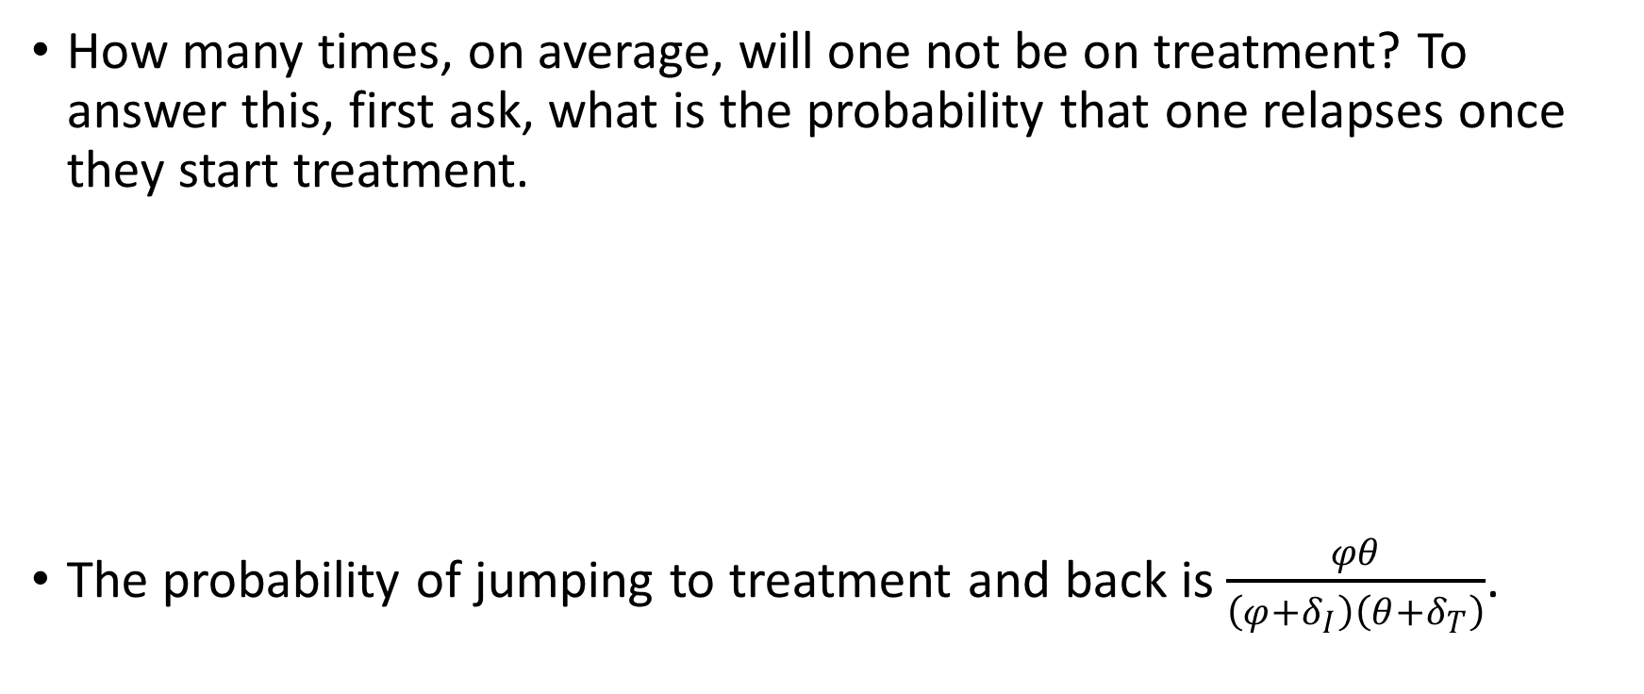

Expected number of visits
How many times, on average, will one not be on treatment? To answer this, first ask, what is the probability that one relapses once they start treatment.
The probability of jumping to treatment and back is $\frac{φθ}{\left(φ+δ_{I}\right)\left(θ+δ_{T}\right)}$.
Probability of
transition
$$\frac{φ}{φ+δ_{I}}$$
Probability of
transition
$$\frac{θ}{θ+δ_{T}}$$
Infected
Treatment

Slide 37


Expected number of visits
Let us count the number of visits times the probability of making the visit. This will give us the expected number.
First define $x≔\frac{φθ}{\left(φ+δ_{I}\right)\left(θ+δ_{T}\right)}$
$$1$$
Start in the I compartment

Slide 38


Expected number of visits
Let us count the number of visits times the probability of making the visit. This will give us the expected number.
First define $x≔\frac{φθ}{\left(φ+δ_{I}\right)\left(θ+δ_{T}\right)}$
Make a return visit
$$1+x$$
Start in the I compartment

Slide 39

Expected number of visits
Let us count the number of visits times the probability of making the visit. This will give us the expected number.
First define $x≔\frac{φθ}{\left(φ+δ_{I}\right)\left(θ+δ_{T}\right)}$
Make a return visit
$$1+x+x^{2}$$
Come back twice
Start in the I compartment

Slide 40
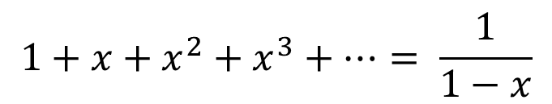
Expected number of visits
Let us count the number of visits times the probability of making the visit. This will give us the expected number.
First define $x≔\frac{φθ}{\left(φ+δ_{I}\right)\left(θ+δ_{T}\right)}$
Make a return visit
$$1+x+x^{2}+x^{3}+…= \frac{1}{1−x}$$
Come back twice
Start in the I compartment

Slide 41
Aside
Is it reasonable that probability of relapse is the same every time one goes on treatment?
Well, whether it is or not, it’s tacitly baked into the model assumptions.
As always, it’s very important to understand the tacit assumptions of your model.

Slide 42
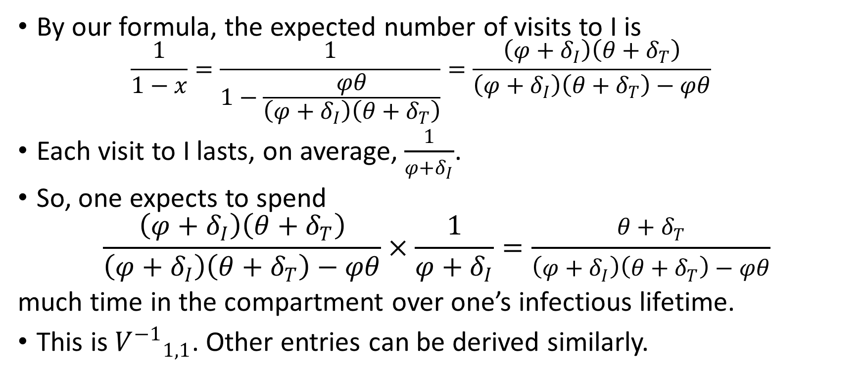
Expected number of visits
By our formula, the expected number of visits to I is
$$\frac{1}{1−x}=\frac{1}{1−\frac{φθ}{\left(φ+δ_{I}\right)\left(θ+δ_{T}\right)}}=\frac{\left(φ+δ_{I}\right)\left(θ+δ_{T}\right)}{\left(φ+δ_{I}\right)\left(θ+δ_{T}\right)−φθ}$$
Each visit to I lasts, on average, $\frac{1}{φ+δ_{I}}$.
So, one expects to spend
$$\frac{\left(φ+δ_{I}\right)\left(θ+δ_{T}\right)}{\left(φ+δ_{I}\right)\left(θ+δ_{T}\right)−φθ}×\frac{1}{φ+δ_{I}}=\frac{θ+δ_{T}}{\left(φ+δ_{I}\right)\left(θ+δ_{T}\right)−φθ}$$
much time in the compartment over one’s infectious lifetime.
This is ${V^{−1}}_{1,1}$. Other entries can be derived similarly.

Slide 43




Graph-theoretic interpretation
Write the adjacency matrix $A$of the weighted, directed graph of the infected compartments such that $A_{m,n}$ is the probability of moving from compartment $n$ to compartment $m$
Probability of
transition
$$\frac{φ}{φ+δ_{I}}$$
Probability of
transition
$$\frac{θ}{θ+δ_{T}}$$
Infected
Treatment
$$A=\left[\begin{matrix}0 & \frac{θ}{θ+δ_{T}} \\ \frac{φ}{φ+δ_{I}} & 0\end{matrix}\right]$$

Slide 44

Graph-theoretic interpretation
Then
$$M=I+A+A^{2}+A^{3}+…={\left(I−A\right)}^{−1}$$
is the matrix who $\left(i,j\right)$ entry is the expected number of visits to compartment $i$ if you start in compartment $j$.
So, we can write $V^{−1}$ as the product of waiting times and this matrix of expected visits

Slide 45

Graph-theoretic interpretation
Average time spent in a visit to I
Probability of going T to I
Waiting times matrix
Expected visits matrix
$$V^{−1}=\left[\begin{matrix}\frac{1}{φ+δ_{I}} & 0 \\ 0 & \frac{1}{θ+δ_{T}}\end{matrix}\right]×{\left(\left[\begin{matrix}1 & 0 \\ 0 & 1\end{matrix}\right]−\left[\begin{matrix}0 & \frac{θ}{θ+δ_{T}} \\ \frac{φ}{φ+δ_{I}} & 0\end{matrix}\right]\right)}^{−1}$$
Average time spent in a visit to T
Probability of going I to T

Slide 46
Exercises
Environmental transmission
Vectorborne transmission
Between- and within-subgroup transmission

Slide 47

Take-aways and suggestions
A geometric interpretation of the next generation matrix helps explain why the basic reproduction is the spectral radius
Stepping through interpretations for the entries of $F,V^{−1}$, and $FV^{−1}$ can help make understanding $R_{0}$ easier
$R_{0}$ depends on what we decide counts as a new infection. This is an epidemiological not mathematical decision.
Calculating and interpreting $R_{0}$ for simpler models than your target model can build intuition

Slide 48
Further reading
R0 and the next generation matrix
O. Diekmann, J. A. P. Heesterbeek, J. A. J. Metz, On the definition and the computation of the basic reproduction ratio R0 in models for infectious diseases in heterogeneous populations, Journal of Mathematical Biology 28 (4) (1990) 365-382.
O. Diekmann, J. A. P. Heesterbeek, Mathematical epidemiology of infectious diseases: model building, analysis and interpretation, John Wiley & Sons, 2000.
P. Van Den Driessche, J. Watmough, Reproduction numbers and sub- threshold endemic equilibria for compartmental models of disease transmission., Mathematical Biosciences 180 (2002) 29-48.
O. Diekmann, J. A. P. Heesterbeek, M. G. Roberts, The construction of next-generation matrices for compartmental epidemic models, Journal of the Royal Society, Interface 7 (47) (2010) 873{885.

Slide 49
Further reading
General reading
R. M. Anderson, R. M. May, Infectious Diseases of Humans: Dynamics and Control, Oxford University Press, Oxford, 1992.
H. W. H. Hethcote, The mathematics of infectious diseases, SIAM review 365 42 (4) (2000) 599-653
M. J. Keeling, P. Rohani, Modeling infectious diseases in humans and animals, Princeton University Press, 2011.
A. J. Kucharski, The Rules of Contagion, Prole Books Ltd, London, 2020.
Type and target reproduction numbers
M. G. Roberts, J. A. P. Heesterbeek, A new method for estimating the eort required to control an infectious disease, Proceedings of the Royal Society of London. Series B: Biological Sciences 270 (1522) (2003) 1359-64.
Z. Shuai, J. A. P. Heesterbeek, P. van den Driessche, Extending the type reproduction number to infectious disease control targeting contacts between types, Journal of Mathematical Biology 67 (5) (2013) 1067{82.

